Slide 1
TEST DRIVEN DEVELOPMENT

Slide 2
What is TDD?
What is TDD?
Test-Driven Development (or test driven design) is a methodology.
Common TDD misconception:
1.TDD is not about testing
2.TDD is about design and development
3.By testing first you design your code

Slide 3
...
Test-driven development (TDD) is a software development process that relies on the repetition of a very short development cycle: first the developer writes an (initially failing) automated test case that defines a desired improvement or new function, then produces the minimum amount of code to pass that test, and finally refactors the new code to acceptable standards
Kent Beck, who is credited with having developed or 'rediscovered'^{[1]} the technique, stated in 2003 that TDD encourages simple designs and inspires confidence.^{[2]}
Test-driven development is related to the test-first programming concepts of extreme programming, begun in 1999,

Slide 4
What Can be Tested?
Valid Input
In-valid Input
Exceptions
Boundary Conditions
Everything that should be possible break.

Slide 5
Comparison
Traditional Approach
Problems with Traditional
  Test last
  Errors in production
  Programmer moves onto other projects
  Test and code written by different programmers
  Tests based on outdated information
  Infrequent testing
  Fixes that create other problems

Slide 6
Advantages
Higher quality
Flexibility
Readability
Maintainability
Scalability
Predictability
Integral and external quality maintained
A well designed application

Slide 7
Cost of development
Cost
Time
Traditional
TDD
Notes:
Turnover in people
Increase in complexity due to interactions between components of the system

Slide 8
Disadvantages of TDD
Test writing is time consuming
Test completeness is difficult to judge
Estimation maybe wrong

Slide 9
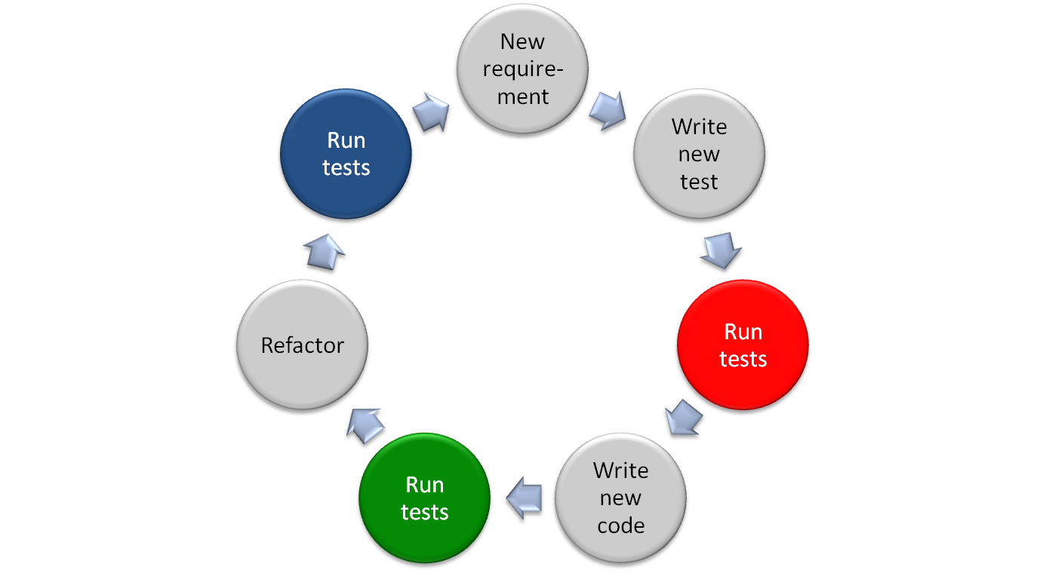
TDD cycle
Make it Better
Make it Fail
Make it Work
Notes:
Test-Driven Development – cycle:
1. Write a test that fails
2. Run tests – why should we – to make sure the test actually checks the right thing
3. Write code
4. Run tests
5. Refactor
6. Run tests
Repeat (if nessesary)

Slide 10
TDD Cycle
Write Test Code
  Guarantees that every functional code is testable
  Provides a specification for the functional code
  Helps to think about design
  Ensure the functional code is tangible
Write Functional Code
  Fulfill the requirement (test code)
  Write the simplest solution that works
  Leave Improvements for a later step
  The code written is only designed to pass the test
    no further (and therefore untested code is not created).
Refactor(process of restructuring existing computer code without changing its external behavior)
  Clean-up the code (test and functional)
  Make sure the code expresses intent
  Re-think the design
  Delete unnecessary code

Slide 11
TDD in a nutshell
Gives feedback on quality of implementation(does it work) and design(is it well structured)
Writing Tests:
makes us clarify the acceptance criteria for the next piece of work - we have to ask ourselves
encourages us to write loosely coupled components, so they can easily be tested in isolation and , at higher levels, combined together (Design);

Slide 12
..
whereas running tests:
• detects errors while the context is fresh in our mind (Implementation); and,
• lets us know when we’ve done enough, discouraging “gold plating” and unnecessary features
(Design)

Slide 13
CATEGORIES OF TESTS
Unit
Integration
Acceptance
Can Encompass “system” Or “functional” Tests
End-to-end Is Desirable When Feasible

Slide 14
Most Important
->Do not
write the code in your head
before you write the test
->"know" what the design should be. You "know" what code you want to write. So you write a test that will let you write that bit of code.

Slide 15
..
When you do this you aren't really doing TDD – since you are writing the code first (even if the code is only in your head ☺)
It takes some time to (and some poking by clever folk) to realize that you need to focus on the test. Write the test for the behavior you want - then write the minimal code needed to make it pass - then let the design emerge through refactoring. Repeat until done.

Slide 16
Unbounded stack example
Requirement: FILO / LIFO messaging system
Brainstorm a list of tests for the requirement:
  Create a Stack and verify that IsEmpty is true.
  Push a single object on the Stack and verify that IsEmpty is false.
  Push a single object, Pop the object, and verify that IsEmpty is true.
  Push a single object, remembering what it is; Pop the object, and verify that the two objects are equal.
  Push three objects, remembering what they are; Pop each one, and verify that they are removed in the correct order.
  Pop a Stack that has no elements.
  Push a single object and then call Top. Verify that IsEmpty is false.
  Push a single object, remembering what it is; and then call Top. Verify that the object that is returned is the same as the one that was pushed.
  Call Top on a Stack with no elements.

Slide 17
...
a few additional tests came to mind, so we need to add them to our test list.
We want to add tests to verify that the Stack works when the arguments are equal to null. The new tests are as follows:
  Push null onto the Stack and verify that IsEmpty returns false.
  Push null onto the Stack, Pop the Stack, and verify that the value returned is null.
  Push null onto the Stack, call Top, and verify that the value returned is null.

Slide 18
TOOLS OF THE TRADE
Unit Test Framework
Mocking Framework
Automated Build Tool
Acceptance Test Framework (often The Same As The Unit Test Framework)
Source Code Management
Build And Continuous Integration Servers
Test Coverage Tools
Code Quality Tools
For Java-based Apps, Consider Using A Dynamic Language (e.g. Groovy) To Write Tests If
You Are Comfortable With It

Slide 19
RECOMMENDATIONS
Unit Test Framework - JUnit 4, Hamcrest Matchers Are Recommended For
Improved Readability And Expressiveness
Mocking Framework - Mockito
Automated Build Tool - Maven
Acceptance Test Framework - Web Services: SoapUI, Web App: Selenium
Source Code Management - Depends On The Project Needs
Continuous Integration - Bamboo Is Nice, Should Be Simple And Easy To Use And
Support Your Build Tool
Test Coverage Tools - Cobertura Or Clover (soapUI Pro For Web Services)
Code Quality Tools - PMD, FindBugs, Checkstyle

Slide 20
THANK YOU

